Slide 1
Predicting Congressional Bill Outcomes using Machine Learning and Large-Scale Computing Methods
Large-Scale Computing for the Social Sciences
Michelle Orden, Kelly Yang, James Midkiff
MACS 30123

Slide 2
Table of Contents
Domain Knowledge
Project Introduction
Data Gathering
Data Preparation
Natural Language Processing
ML Models and Predictions
Conclusions
Works Cited

Slide 3
Domain Knowledge
The U.S. Congress holds legislative powers
Thousands of bills are introduced to Congress each year
Few bills receive votes, and even fewer become laws

Slide 4




Project Introduction
Which features predict whether or not a bill passes and becomes law?
Bill features: Word count, section count, number of sponsors, etc
Global features: Which party holds majority vote in Congress?
Large-Scale Tools/Methods:
S3 Bucket
EMR Clusters and EC2 Instances
Dask on Midway Cluster
PySpark
Logistic Regression Model

Slide 5


Data Gathering using EMR Cluster
For each congress:
Step 1: collect all bill packageIds
For each bill:
Step 2: collect all bill texts
Step 3: Store all bill packageIds and texts in dictionary
Step 4: Store dictionary in S3 bucket
Run on EMR cluster using 3 m5.xlarge EC2 instances
Big problem: API throttling - max 1000 requests per hour

Slide 6

Data gathering - Part 2
Download zip files
Upload xml to S3 bucket
For each xml file:
Decode file to utf8 string
Convert xml to dictionary/json representation
Store dictionary back in S3
Used EMR cluster and 1 m4.xlarge EC2 instance

Slide 7
Data gathering continued
Congress | Dates | House Bills | Senate Bills | Total
113 | Jan 3, 2013 -Jan 2, 2015 | 7831 | 3648 | 11479
114 | Jan 6, 2015 -Jan 3, 2017 | 9129 | 4412 | 13541
115 | Jan 3, 2017 -Jan 3, 2019 | 10721 | 4806 | 15527
116 | Jan 3, 2019 -Jan 3, 2021 | 11475 | 5977 | 17452
Total |  | 39156 | 18843 | 57999

Slide 8
Data Preparation & NLP
Focus only on Congressional bills (not Congressional resolutions)
Note that each version of a bill is considered a separate bill
Generate textual features:
Sponsor Count, Section Count, Word Count
NLP Features from textblob package
Subjectivity Score: [0, 1] - How “objective” or “subjective” a text is
Polarity Score: [-1, 1] - How “negative” or “positive” feeling a text is
Prediction label: if a bill was ‘Passed’ by both Chambers
Notes:
Sponsor Count - A count of the total number of congressional sponsors of the bill
Section Count - A count of the number of 'sections' of the bill and 'sections' of other bills that the bill in question amends
Word Count - The number of total words in the bill itself

Slide 9
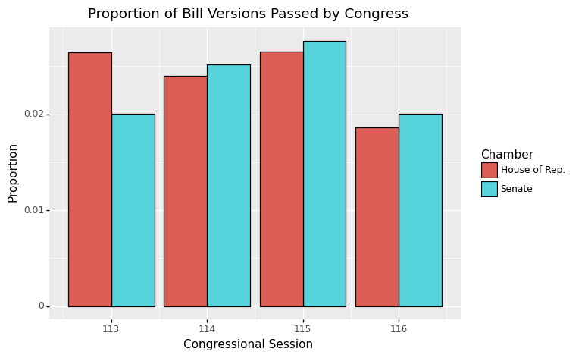
Exploratory Data Analysis
Notes:
Both chambers of Congress exhibit remarkable similarity in terms of the bill outcomes. Only about 2% of bills from each Chamber are passed in any given session.

Slide 10
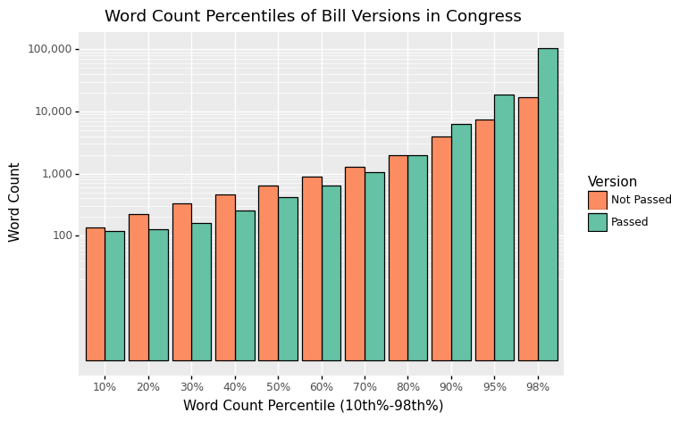
Exploratory Data Analysis - 2
Notes:
Uncontroversial bills may concern minutiae that do not require lengthy laws to address
113th Congress "An Act To specify the size of the precious-metal blanks that will be used in the production of the National Baseball Hall of Fame commemorative coins.", which has a word count of 102.
Highly public and debated legislation may require more concessions, amendments, and "pork" that add to the bill's overall length in order for passage to occur.
The 2017 Tax Cuts and Jobs Act (a.k.a. the Trump Tax Cuts) from the 115th Session of Congress increased from 68,000 to 78,000 words between its introduction in the house and its eventual enactment.

Slide 11
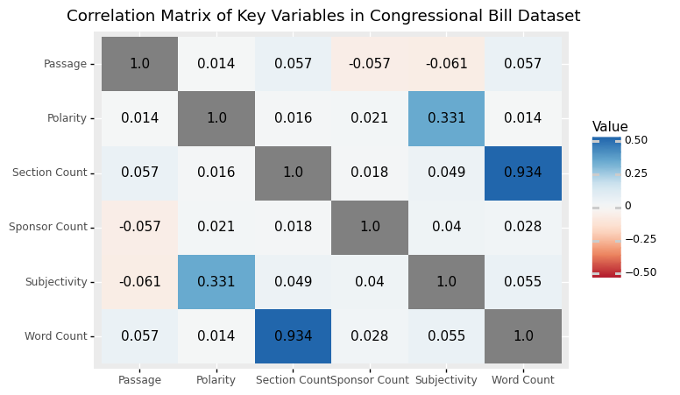
Exploratory Data Analysis - 3
Notes:
As could perhaps be expected, there is near perfect correlation between increasing the number of sections in a congressional bill and the total word count. Most other features are not closely related to each other, except for the polarity and subjectivity scores, which have a mildly positive correlation.

Slide 12
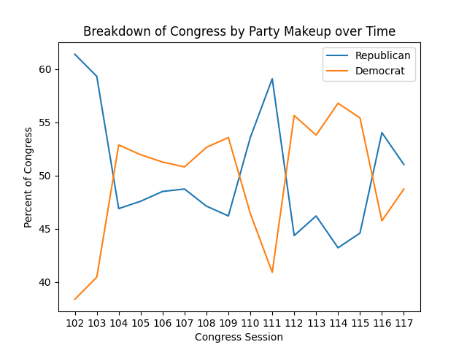
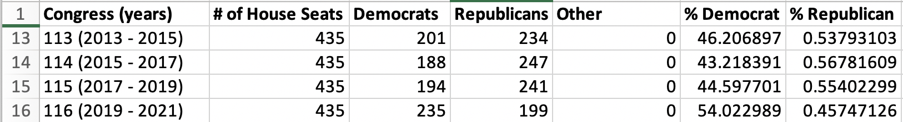
Congress Breakdown
Two Added Features
Percentage Democrat
Percentage Republican

Slide 13
ML Model Preparation & Selection
Load in Bills and Datasets from S3 bucket
Consolidate into dataframe, run on an EMR Cluster on AWS Console
Dask => Pandas => PySpark
Final Features Selected
sponsor_count, section_count, word_count_scaled, subjectivity, polarity, % Democrat, % Republican
Scale word count using PySpark Standard Scaler
Binary Outcome (does the bill pass?)
Multivariate Logistic Regression
efficient to train, binary outcome, ease of implementation, fits our project scope

Slide 14
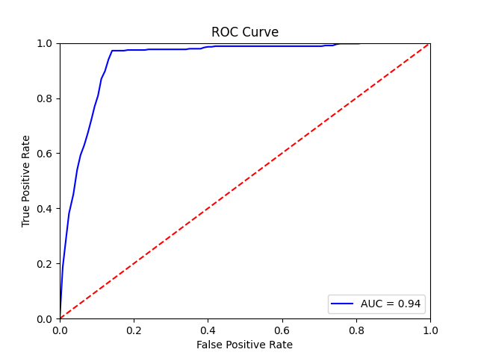
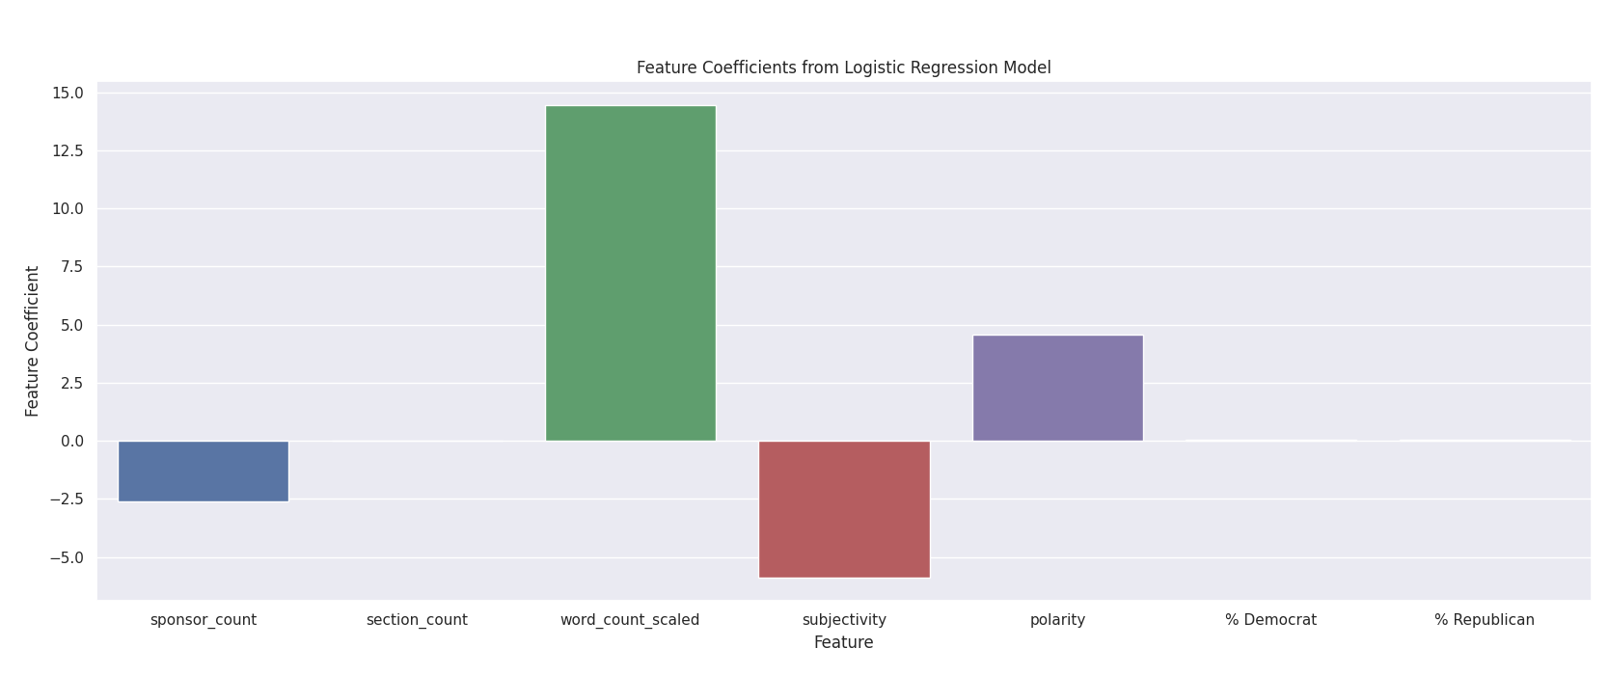
Logistic Regression Results
Ran the multivariate Logistic Regression using PySpark
training and test sets, 80-20 split
Training Accuracy: 0.977034411460641
Test Accuracy: 0.975150992234685

Slide 15
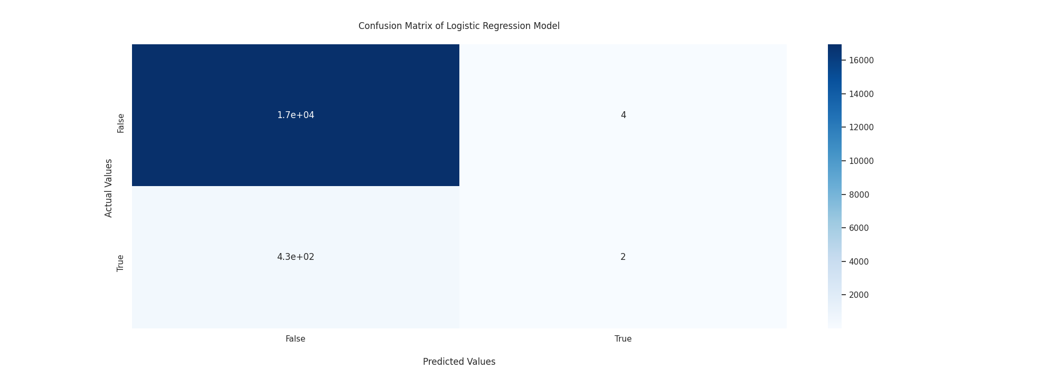
Logistic Regression Results cont.
Accuracy score for our model is 0.975150992234685
Precision score for our model is 0.3333333333333333
Recall score for our model is 0.004651162790697674

Slide 16
Conclusion
Data trained on many more negatives than positives
Downsampling
Scaled word count has the highest positive correlation
Subjectivity is negatively correlated, as is sponsor count
Polarity is positively correlated
Scale model with additional data
Try to eliminate biases

Slide 17
References
https://www.govtrack.us/congress/bills/statistics
https://www.morrisopazo.com/resources/blog-english/using-bootstrap-actions-in-emr-amazon-aws/
https://medium.com/the-freelancer/store-your-images-with-aws-s3-60b7ac167f8b
https://rapids.ai/dask.html
https://blog.cambridgespark.com/unit-testing-with-pyspark-fb31671b1ad8?gi=6c92daae9cb1
https://www.govinfo.gov/
https://api.govinfo.gov/docs/
https://www.govinfo.gov/bulkdata
https://history.house.gov/Institution/Party-Divisions/Party-Divisions/
https://medium.com/swlh/logistic-regression-with-pyspark-60295d41221

Slide 18
Citations continued

